Slide 1
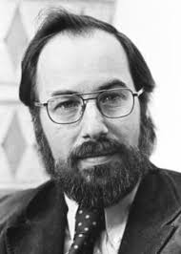
Baltimore Classification of Viruses
Understanding Virus Classification and Examples

Slide 2
Introduction to Baltimore Classification
Baltimore Classification is a system used to classify viruses based on their manner of messenger RNA (mRNA) synthesis. This classification system was created by the Nobel laureate David Baltimore. It consists of seven groups, each representing a different type of virus:
Class I: Double-stranded DNA viruses
Class II: Single-stranded DNA viruses
Class III: Double-stranded RNA viruses
Class IV: Positive sense single-stranded RNA viruses
Class V: Negative sense single-stranded RNA viruses
Class VI: Single-stranded RNA viruses with a DNA intermediate in their life cycle
Class VII: Double-stranded DNA viruses with an RNA intermediate in their life cycle

Slide 3
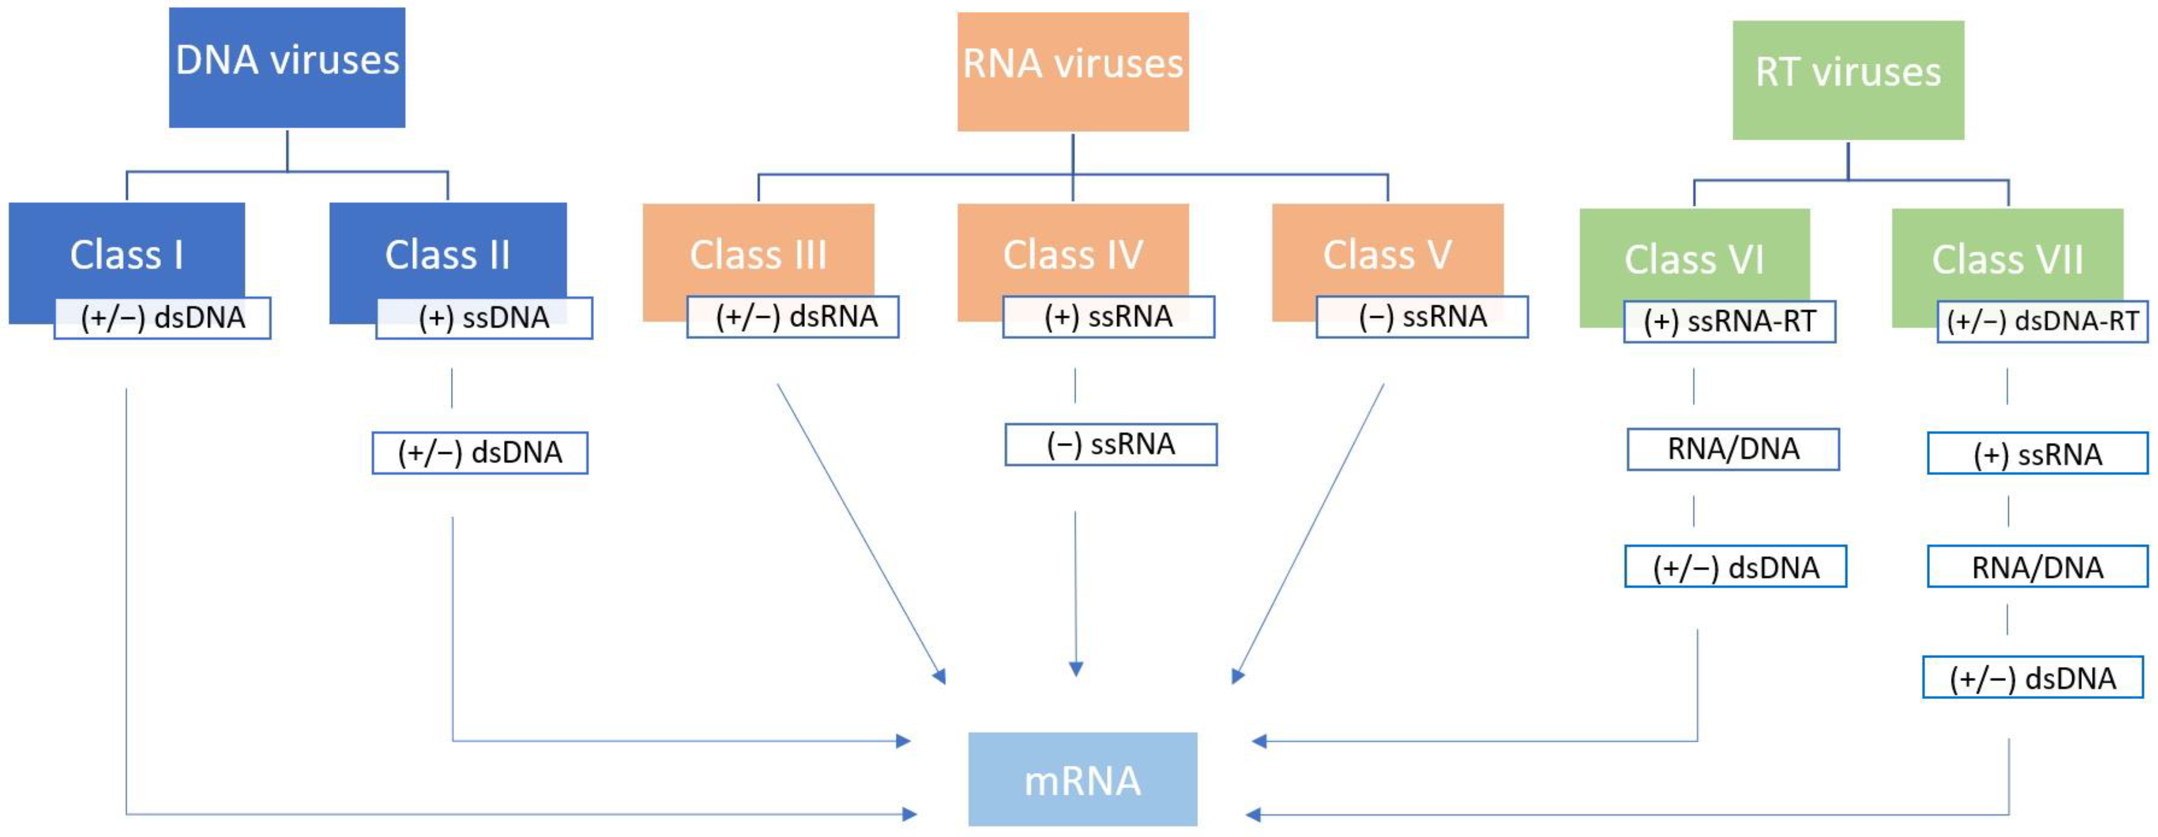

Slide 4
Class I - Double-Stranded DNA (dsDNA) Viruses
This class of viruses is quite diverse, causing a wide range of diseases in humans and other organisms. The understanding of their replication mechanism has been crucial in the development of antiviral therapies.
Genome: Double-Stranded DNA (dsDNA)
Replication: These viruses use the host’s DNA-dependent DNA polymerase for replication. This means they rely on the machinery of the host cell to replicate their DNA.
Examples: Some common examples of dsDNA viruses include Adenoviruses, which can cause a range of illnesses from mild respiratory infections in young children to life-threatening multi-organ disease in people with a weakened immune system, and Herpesviruses, a large family of DNA viruses that cause diseases in animals, including humans.

Slide 5
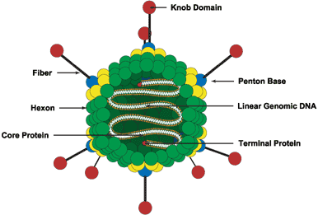
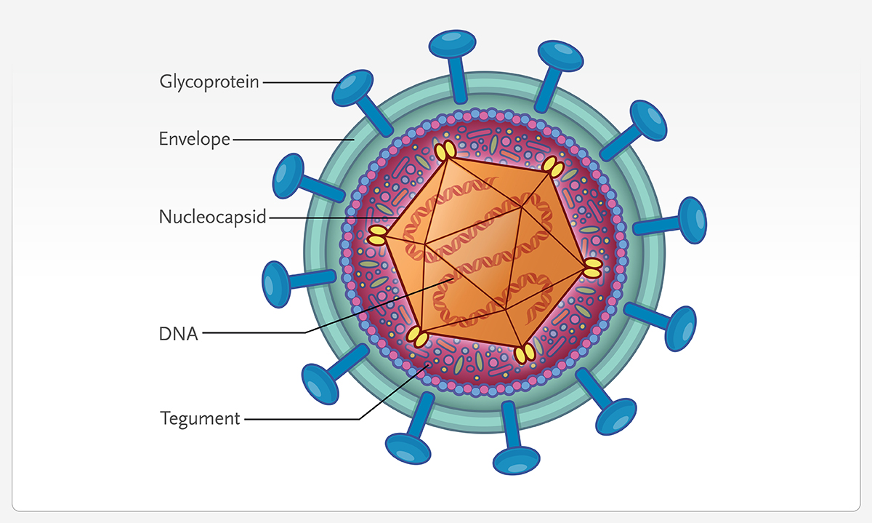
Herpes Virus structure
Structure of Adenovirus

Slide 6
Class II - Single-Stranded DNA (ssDNA) Viruses
These viruses are smaller and simpler than double-stranded DNA viruses. However, they can still cause significant diseases in humans and other organisms. Understanding their replication mechanism is key to developing effective antiviral therapies.
Genome: Single-Stranded DNA (ssDNA)
Replication: These viruses convert their single-stranded DNA into a double-stranded form for transcription. This is done using the host’s replication machinery.
Examples: A common example of ssDNA viruses is Parvovirus. In humans, Parvovirus B19 causes a mild rash illness (fifth disease) in children and can cause serious complications in pregnant women.

Slide 7
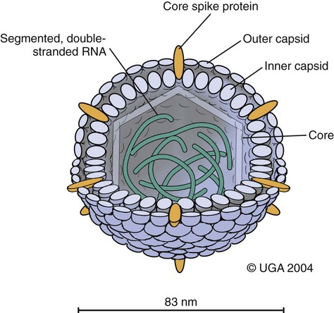
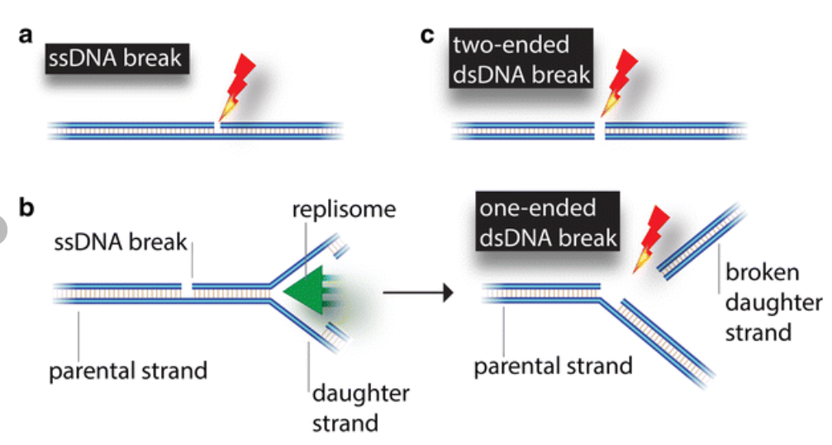
ssDNA to dsDNA conversion
Structure of Parvovirus

Slide 8
Class III - Double-Stranded RNA (dsRNA) Viruses
These viruses have a unique replication mechanism that involves the synthesis of RNA from an RNA template, which is quite different from the DNA replication that occurs in host cells. Understanding this unique replication mechanism is crucial for the development of antiviral therapies.
Genome: Double-Stranded RNA (dsRNA)
Replication: These viruses use an enzyme called RNA-dependent RNA polymerase for replication. This enzyme synthesizes a new strand of RNA based on the template provided by the viral RNA.
Examples: A well-known example of dsRNA viruses is Rotavirus, which is a common cause of severe diarrhea in infants and young children worldwide.

Slide 9
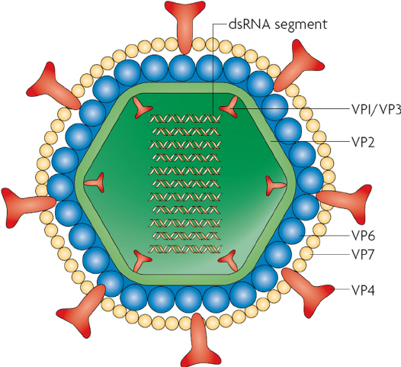
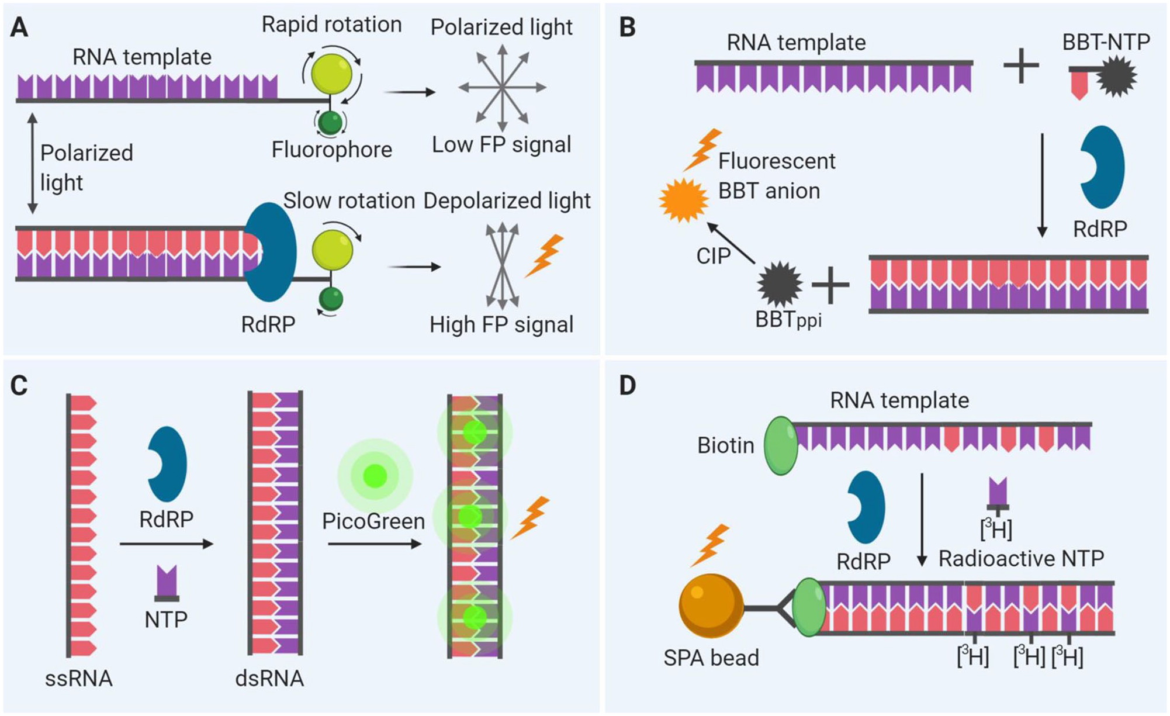
RNA-dependent RNA polymerase activity
Structure of Rotavirus

Slide 10
Class IV - Positive-Sense Single-Stranded RNA (+ssRNA) Viruses
These viruses have a unique replication strategy that allows them to hijack the host’s protein synthesis machinery more directly compared to other types of viruses. This makes them particularly efficient in their replication and spread, but also provides potential targets for antiviral therapies.
Genome: Positive-Sense Single-Stranded RNA (+ssRNA)
Replication: The +ssRNA acts as mRNA and is directly translated into proteins by the host’s ribosomes. This is a unique feature of +ssRNA viruses.
Examples: Poliovirus, which causes polio, and SARS-CoV-2, the virus responsible for COVID-19, are both examples of +ssRNA viruses.

Slide 11
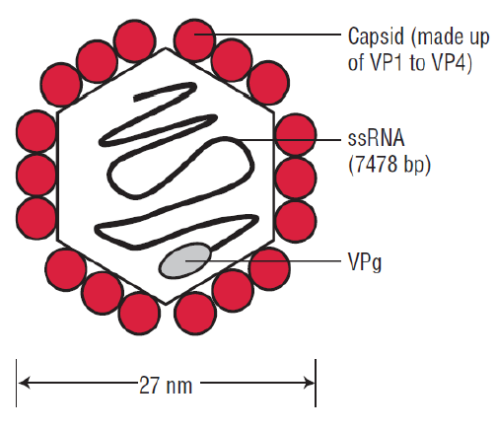
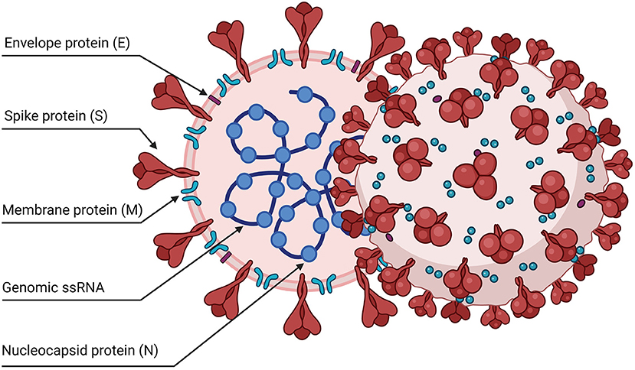
SARS-CoV-2
Structure of Poliovirus

Slide 12
Class V - Negative-Sense Single-Stranded RNA (-ssRNA) Viruses
These viruses have a unique replication strategy that involves the synthesis of +ssRNA from a -ssRNA template. This additional step in the replication process provides potential targets for antiviral therapies. Understanding this unique replication mechanism is crucial for the development of antiviral therapies.
Genome: Negative-Sense Single-Stranded RNA (-ssRNA)
Replication: These viruses must first transcribe their -ssRNA into positive-sense RNA (+ssRNA) for protein synthesis. This is done using a viral enzyme called RNA-dependent RNA polymerase.
Examples: Influenza virus, which causes the flu, and Ebola virus, which causes Ebola virus disease, are both examples of -ssRNA viruses.

Slide 13
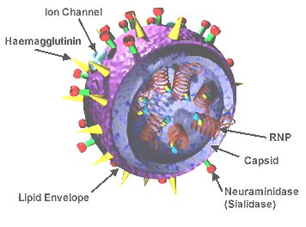

Ebola virus
Structure of Influenza virus

Slide 14
Class VI - Retroviruses (RNA Reverse-Transcribing Viruses)
Retroviruses are unique in their ability to integrate their genome into the host’s DNA, which allows them to persist in the host cell indefinitely. This makes them particularly challenging to treat, but also provides unique targets for antiviral therapies. Understanding this unique replication mechanism is crucial for the development of antiviral therapies.
Genome: Positive-Sense Single-Stranded RNA (+ssRNA) with reverse transcriptase. This enzyme is unique to retroviruses and allows them to convert their RNA genome into DNA.
Replication: Retroviruses have a unique replication process. They convert their RNA genome into DNA using the enzyme reverse transcriptase. This newly synthesized DNA is then integrated into the host cell’s genome, where it can be transcribed and translated using the host’s machinery.
Examples: The most well-known example of a retrovirus is the Human Immunodeficiency Virus (HIV), which causes AIDS.

Slide 15
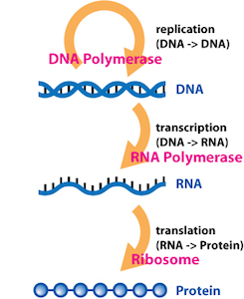
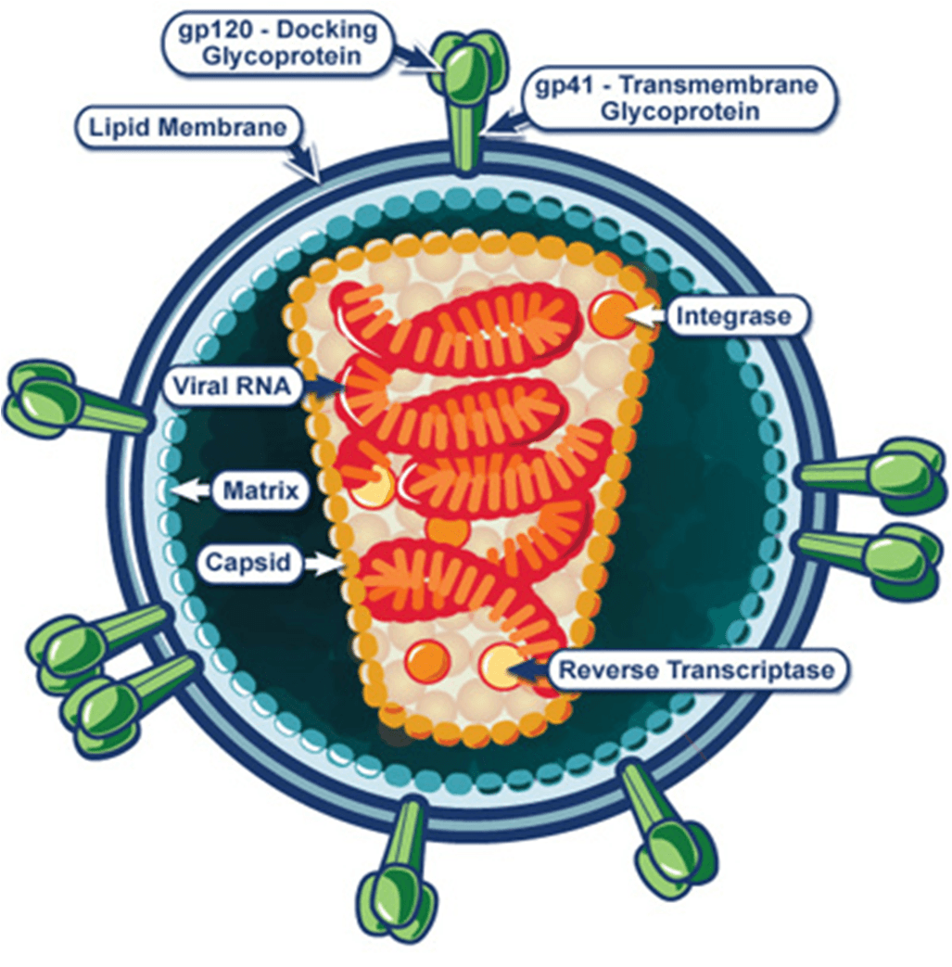
Structure of HIV
Reverse Transcription Process

Slide 16
Class VII - Double-Stranded DNA (dsDNA) Viruses with Reverse Transcriptase
These viruses are unique in their ability to reverse transcribe their RNA back into DNA, which provides potential targets for antiviral therapies. Understanding this unique replication mechanism is crucial for the development of antiviral therapies. This class of viruses is particularly challenging to treat due to their ability to integrate their DNA into the host’s genome.
Genome: Double-Stranded DNA (dsDNA) with reverse transcriptase. This enzyme allows these viruses to transcribe their DNA into RNA and then back into DNA.
Replication: These viruses have a unique replication process. Their DNA is first transcribed into RNA, which is then reverse transcribed back into DNA using the enzyme reverse transcriptase. This newly synthesized DNA can then be integrated into the host cell’s genome, where it can be transcribed and translated using the host’s machinery.
Examples: The Hepatitis B virus, which causes hepatitis B, a serious liver infection, is a well-known example of a dsDNA virus with reverse transcriptase.

Slide 17
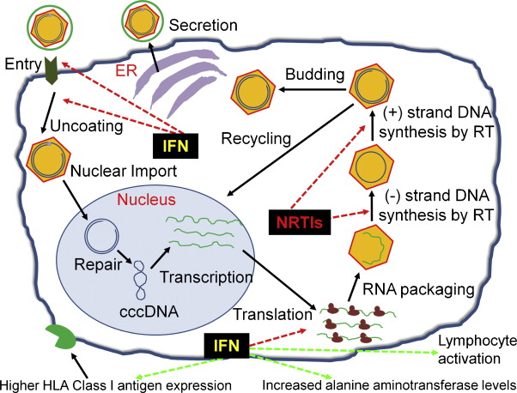
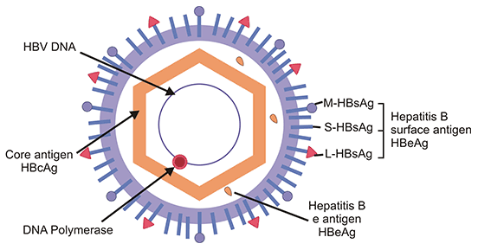
Structure of Hepatitis B virus
Reverse Transcription Process in Hepatitis B

Slide 18
Summary of key differences between classes
Class I - dsDNA Viruses: These viruses have a double-stranded DNA genome and use the host’s DNA-dependent DNA polymerase for replication. Examples include Adenovirus and Herpesvirus.
Class II - ssDNA Viruses: These viruses have a single-stranded DNA genome and convert their ssDNA into dsDNA for transcription. An example is Parvovirus.
Class III - dsRNA Viruses: These viruses have a double-stranded RNA genome and use RNA-dependent RNA polymerase for replication. An example is Rotavirus.
Class IV - +ssRNA Viruses: These viruses have a positive-sense single-stranded RNA genome that acts as mRNA and is directly translated into proteins. Examples include Poliovirus and SARS-CoV-2.

Slide 19
Summary of key differences between classes
Class V - -ssRNA Viruses: These viruses have a negative-sense single-stranded RNA genome that is transcribed into +ssRNA for protein synthesis. Examples include Influenza virus and Ebola virus.
Class VI - Retroviruses: These viruses have a +ssRNA genome with reverse transcriptase that converts RNA to DNA, which then integrates into the host genome. An example is HIV.
Class VII - dsDNA Viruses with Reverse Transcriptase: These viruses have a dsDNA genome with reverse transcriptase that transcribes DNA into RNA, then back to DNA. An example is Hepatitis B virus.

Slide 20
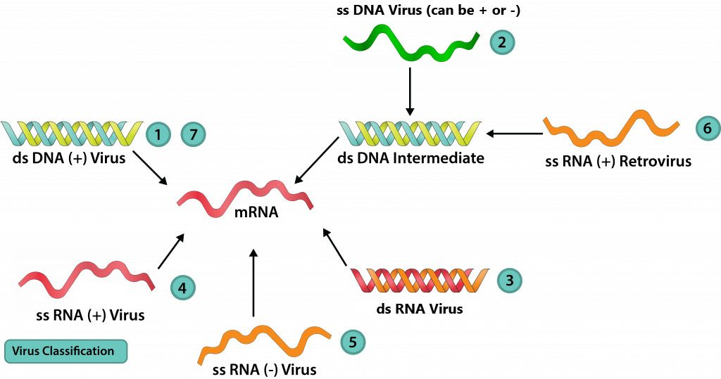

Slide 21
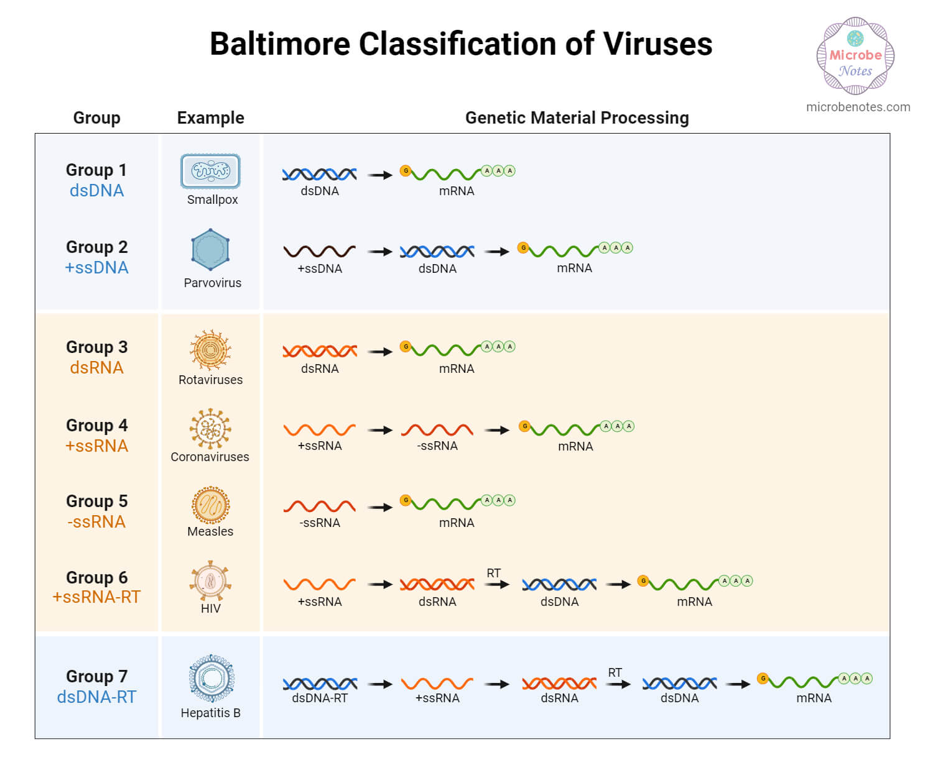


Slide 22
Importance of understanding these differences
Understanding these differences is crucial in virology as it helps in predicting the replication process, understanding virus-host interactions, and informing therapeutic strategies. Each class of viruses has a unique replication mechanism, providing potential targets for antiviral therapies. This classification system is a fundamental framework in microbiology for the classification of viruses. It aids in the development of antiviral drugs and the management of infections. Understanding this classification system is essential for anyone studying or working in the field of virology. It’s also important for public health officials and healthcare providers in managing and preventing viral diseases.

Slide 23
Future Directions in Virology Research
Understanding Virus-Host Interactions: Future research in virology will continue to focus on understanding the complex interactions between viruses and their host cells. This includes studying how viruses enter cells, replicate, and evade the host’s immune response.
Development of Antiviral Therapies: The unique replication mechanisms of each class of viruses provide potential targets for antiviral therapies. Future research will focus on developing new drugs that can target these mechanisms and prevent viral replication.
Vaccine Development: Vaccines are one of the most effective ways to prevent viral diseases. Future research will focus on developing new vaccines, especially for viruses that currently have no effective vaccines.
Viral Genomics and Evolution: As sequencing technologies continue to improve, there will be a greater focus on studying viral genomics and evolution. This can provide insights into how viruses evolve and adapt.

Slide 24
Conclusion
Significance of Baltimore Classification The Baltimore Classification system is a fundamental framework in virology. It classifies viruses into seven groups based on their manner of mRNA synthesis. This classification allows scientists to understand and predict the likely behaviors of viruses based on their genomic nucleic acid characteristics. It aids in predicting the replication process, understanding virus-host interactions, and informing therapeutic strategies. Each class of viruses has a unique replication mechanism, providing potential targets for antiviral therapies. Understanding this classification system is essential for anyone studying or working in the field of virology. It’s also important for public health officials and healthcare providers in managing and preventing viral diseases.
In conclusion, the Baltimore Classification system has greatly contributed to our understanding of viruses and continues to guide research in virology. The future of virology research looks promising, with many exciting directions and potential breakthroughs on the horizon.

Slide 25
Thank you

